Slide 1
MGT 388 Finance and Law for Engineers
Capital Investment Decision
Sajid Bashir

Slide 2
Contents
What is Capital Investment Appraisal?
Payback
NPV
IRR
ARR

Slide 3
Investment
An investment involves foregoing consumption now, in anticipation of the opportunity to consume more in the future.
A particular opportunity to invest is known as ‘Project’. For e.g.
Opening a new branch
Building a new factory
Buying a new machine
Purchase of van
Significant upgrade of existing equipment
Investment Appraisal involves
identification of future cash flows which are relevant to the project.
Estimate the scale of future cash inflows/outflows
Ascertain timing of these future cash inflow /outflow
Comparison with a set standard or among projects to determine their suitability
Notes:
The purpose of an investment is to alter cash flows in future by changing direction of cash flow presently.
An investment decision will involve the consideration whether the proposed expenditure on a given project will generate adequate wealth in the future to warrant forgoing the current opportunities for consumption.
Also – when there is a range of options are available, which of these is likely to generate highest financial return.

Slide 4



Capital Investment Appraisal
To achieve the business strategy an investment in a project, contract or new development may be required.
An investment decision often requires a considerable financial outlay with returns expected over an extended time period.

Slide 5


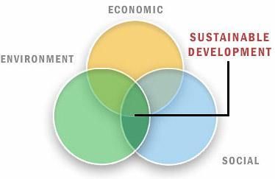
Capital Investment Appraisal
If only one project is available need to decide whether to invest or not.
Where more than one project is available need to decide which project to invest in. Capital Rationing.
When deciding on an investment must consider:
Risk and uncertainty
Monetary returns
Non-monetary business objectives.

Slide 6
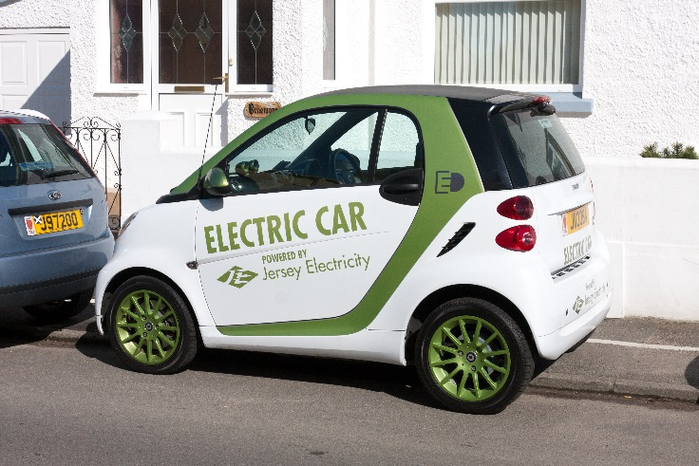

Examples of Capital Investment
Dyson – develop a suite of electric
cars by 2020. £2bn investment
in the car and battery.
JD.com -$397m investment to launch a standalone ecommerce platform to target buyers of luxury goods in small cities in China

Slide 7


Examples of Capital Investment
Rolls Royce - £100m on smart
machine tools in Tyne and Wear factory
reducing time to make turbine discs
For one component time reduced from
118 hour to30 hours.
Sheffield University - £200m in buildings in two years.

Slide 8
Appraisal Techniques
All the investment appraisal techniques consider cash flows rather than profits as cash does not suffer from accounting allocations and is a better predictor of future wealth.
Main appraisal techniques are:
Accounting rate of return
Payback period
Net present value
Internal rate of return

Slide 9
Example 1
INVESTMENT
A project will require an initial investment of £200,000 and will last 5 years.
At the end of 5 years some of the equipment can be sold off for £10,000.
SALES
The sales revenue will be £75,000 in year 1, £85,000 in years 2 and 3, £60,000 in year 4 and £50,000 in year 5.
COSTS
Labour costs are expected to be £25,000 for each year.
Material costs will be £2,000 in year 1, £3,000 in years 2 and 3, £2,000 in year 4 and £1,000 in year 5.

Slide 10
Calculation of net cash flow
Year | Investment/ Scrap | Labour | Materials | Revenue | Net Cash flow
0 | (200,000) |  |  |  | (200,000)
1 |  | (25,000) | (2,000) | 75,000 | 48,000
2 |  | (25,000) | (3,000) | 85,000 | 57,000
3 |  | (25,000) | (3,000) | 85,000 | 57,000
4 |  | (25,000) | (2,000) | 60,000 | 33,000
5 | 10,000 | (25,000) | (1,000) | 50,000 | 34,000
Total | (190,000) | (125,000) | (11,000) | 355,000 | 29,000

Slide 11
Accounting rate of return
ARR = Average expected return X 100% Average capital employed/investment
Average expected return=£355,000-11,000-125,000 5 years
= £219,000/5 years = £43,800
Average investment =200,000+10,000 =£105,000
2
ARR = £43,800 =42%
£105,000

Slide 12
Accounting rate of return
Simple and easy to calculate. Easy to understand.
Very similar to Return on capital employed- seen as key ratio by investors
Projects judged by ARR are assessed internally in the same way as assessed externally.
But attaches same value to cash flows whether received in year 1 or year 5
Should ARR be calculated before or after depreciation.
Doesn’t consider size of investment. An investment of £40,000 with ARR of 10% generates £4,000. An investment of £400,000 with ARR of 10% generates £40,000.

Slide 13
Payback period
The payback period is the length of time it takes for an initial investment to be repaid out of the net cash inflows from a project.
Year Net Cash flow Cumulative net cash flow
0 (200,000) (200,000)
1 48,000 (152,000)
2 57,000 (95,000)
3 57,000 (38,000)
4 33,000 (5,000)
5 34,000 29,000

Slide 14
Payback period
For the above project it takes between 4 and 5 years to payback the initial investment of £200,000.
Assuming the £34,000 inflow in year 5 accrued evenly at (£34,000/12 months) = £2,833 per month.
The payback period is approximately 4 year 2 months.

Slide 15
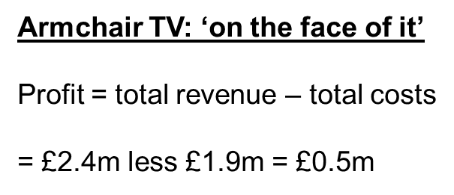
Example 2 Payback Period
"Armchair TV" are considering buying the television rights to the Albanian premier (soccer) league, at an immediate cost of £1.9m. They will then re- package the games and sell programmes to cable networks, with expected revenues as follows:
Worked example: Armchair TV
Pay £1.9 m NOW
Revenue end Yr 1 £200,000
Revenue end Yr 2 £300,000
Revenue end Yr 3 £350,000
Revenue end Yr 4 £350,000
Revenue end Yr 5 £400,000
Revenue end Yr 6 £400,000
Revenue end Yr 7 £300,000
Revenue end Yr 8 £100,000

Slide 16
Payback Period
The payback period calculation; need to re- coup £1.9m
Annual Cumulative
Inflows (£) Inflows (£k)
Yr 1 200,000 200,000
Yr 2 300,000 500,000
Yr 3 350,000 850,000
Yr 4 350,000 1,200,000
Yr 5 400,000 1,600,000
Yr 6 400,000 2,000,000
Yr 7 300,000 Irrelevant
Yr 8 100,000 irrelevant
The payback period calculation
After 5 yrs £1.6m re-couped
After 6 yrs £2.0m re-couped
We only require £1.9m to pay-back
therefore 'payback' occurred at:
5 yrs plus (0.3m / 0.4m) x 12 months
giving 5 yrs 9 months overall

Slide 17
Payback
Strengths of Payback Period
Minimises impact of long term risk – like change of government, Chances of competitors producing copy products
Quick and simple to calculate and managers easily understand it.
Avoids obvious difficulties in projecting cash flow several years from hence.
Weaknesses of Payback Period
Difficulties in predicting what expenditure has to be paid – Especially when large negative cashflow at the end of the project is present.
Ignores time value of money.
Favours short term projects over long term projects .

Slide 18
Time value of money
Compounding
£100 invested today at 10% p.a. is worth £110 in 1 yr.
In 2 years it will be worth £110 x 110%, i.e. £121
In 3 years it will be worth £121 x 110%, i.e. £133
To find out what £100 invested for 3 years at 10% is:
£100 x 1.10³ ⁼ £133

Slide 19
Time Value of Money
Discounting
If we know we are to receive £133 in 3 years' time, how much is that worth now, given that the rate of interest is 10%?
The answer is:
£133 X 1 = £100
(1.10)³
1 = 0.751
(1.10)³
0.751 is the ‘discount factor’ (for 3 years at 10%).
Tables are provided for discount factors they do not need to be calculated

Slide 20
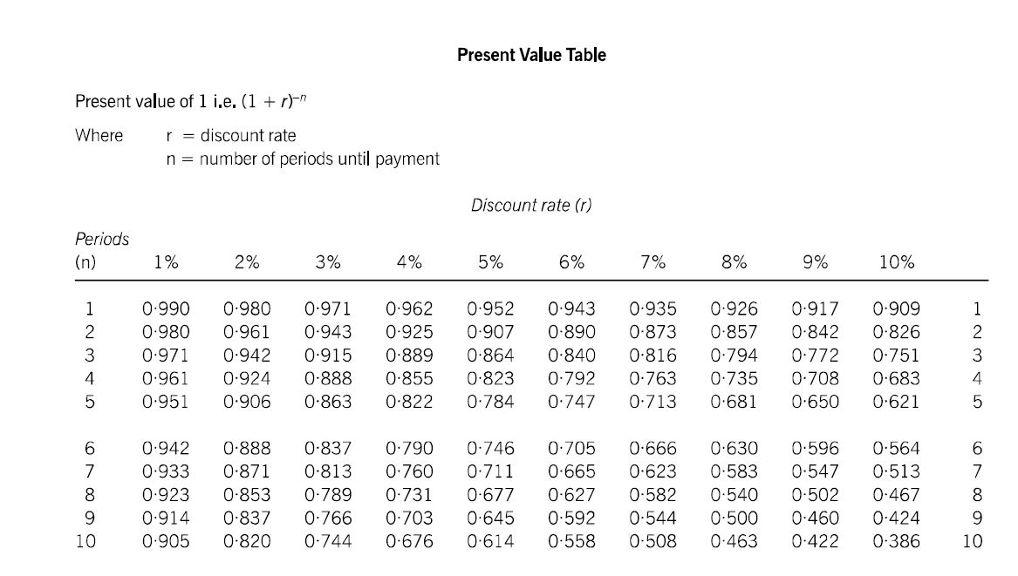
Present Value Tables

Slide 21
Time value of money
Discounting
With investment appraisal we use the reverse of compounding.
We estimate cash flows we expect in future years and discount them at an appropriate rate.
The rate used for discounting takes into account inflation but also the firm’s required rate of return.
The required rate of return on a project depends on the risk involved and the opportunity cost of not investing the funds elsewhere.
The discount rate a business uses for investment appraisal is known as its cost of capital.

Slide 22
Net present value
Having established the timing and amount of future cash flows the firms cost of capital can be applied to bring those cash flows to their present value.
The total of the present values is the net present value of a project.
If the net present value is positive the project should be accepted.
If the net present value is negative the project should be rejected.

Slide 23
Net present value
Decide whether to accept the project if the firm’s cost of capital is 7%
Year Net Cash flow Discount Factor Net present value
£ £
0 (200,000) 1 (200,000)
1 48,000 0.935 44,880
2 57,000 0.873 49,761
3 57,000 0.816 46,512
4 33,000 0.763 25,179
5 34,000 0.713 24,242
(9,426)
As the NPV is negative at that cost of capital the project should be rejected.

Slide 24
Example 2 - NPV
"Armchair TV" are considering buying the television rights to the Albanian premier (soccer) league, at an immediate cost of £1.9m. They will then re- package the games and sell programmes to cable networks, with expected revenues as follows:
Worked example: Armchair TV
Pay £1.9 m NOW
Revenue end Yr 1 £200,000
Revenue end Yr 2 £300,000
Revenue end Yr 3 £350,000
Revenue end Yr 4 £350,000
Revenue end Yr 5 £400,000
Revenue end Yr 6 £400,000
Revenue end Yr 7 £300,000
Revenue end Yr 8 £100,000
Lets calculate the present value of each of these cash flows @5%

Slide 25
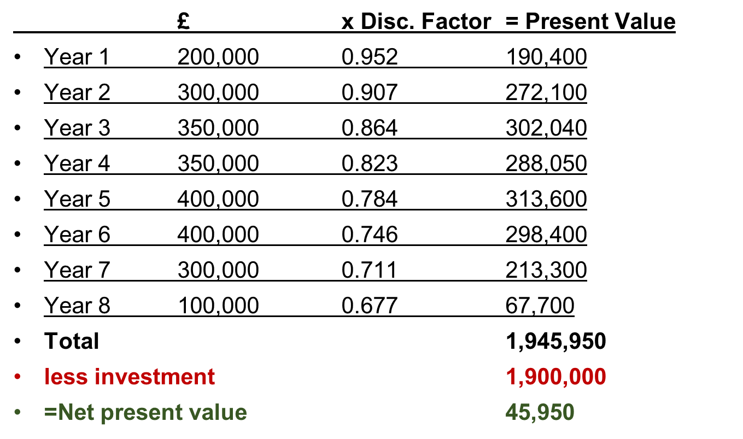
NPV - Calculation

Slide 26
NPV
Invest if NPV is Positive
Do Not Invest if NPV is Negative
If NPV is Zero, investor is indifferent as to whether to invest
In the given example the Investment should go ahead.

Slide 27
NPV
Strengths of NPV
It Recognises the Time Value of Money
It recognises the difference in size of investment
It allows for additivity – So projects whose success depends upon the introduction of subsequent projects , may be added together to find out their combined NPV.
Weaknesses of NPV
Difficult to explain to people not formally trained in Finance
Provides answers in monetary terms, so does not allow comparison for profitability of the project.
Which is better ? Initial Investment NPV
£ 50,000 £25,000
£250,000 £30,000

Slide 28
Internal rate of return
The internal rate of return of a particular investment is the discount rate that, when applied to its future cash flows, will produce an NPV of zero.
The internal rate of return represents the return from an investment opportunity.
The way to obtain an IRR is through a computer package, trial and error with linear interpolation or graphically.

Slide 29
Internal Rate of Return
The NPV is preferred to IRR
Where net cash flows are both positive and negative there can be more than one IRR
IRR is a percentage. A business might be concerned with value of cash flow
YOU WILL NOT BE ASKED TO CALCULATE AN IRR BUT FOR COMPLETENESS THE IRR FOR THE LECTURE EXAMPLE HAS BEEN SHOWN IN THE FINAL SLIDES

Slide 30
Calculating Internal Rate of return
Prepare NPV calculations for two discount rates one which produces a negative NPV and one which produces a positive NPV.
Use linear interpolation to determine the internal rate of return.
For our project we have used a 7% discount rate and obtained a negative NPV.
Re-calculate NPV using a discount rate of 5%

Slide 31
Internal Rate of return
Calculating the net present value using a discount rate of 5%
Year Net Cash flow Discount Factor Net present value
£ £
0 (200,000) 1 (200,000)
1 48,000 0.952 45,696
2 57,000 0.907 51,699
3 57,000 0.864 49,248
4 33,000 0.823 27,159
5 34,000 0.784 26,656
458
If the company had a cost of capital of 5% the project would have been accepted.

Slide 32
Internal rate of return
From the two NPV tables we have two figures either side of zero. Linear interpolation can now be used to estimate the IRR.
The difference in the cash flows are (9,426) + 458 = £9,884
The difference in the discount rate used is (7%-5%)2%
The distance between 7% and IRR is 9,426 X2% = 1.9%
9,884
IRR is 7%-1.9% = 5.1%
The distance between 5% and IRR is 458 X2% = 0.1% 9,884
IRR is 5% +0.1% = 5.1%

Slide 33
Summary
Capital investment appraisal techniques
ARR
Payback
NPV
IRR
Limitations
Worked examples

